Slide 1

Research Question –
Tutorial Presentation for Feedback
Date:
Group Name: A179 Name of Student Presenting: Nandharapu Prasanth kumar

Slide 2
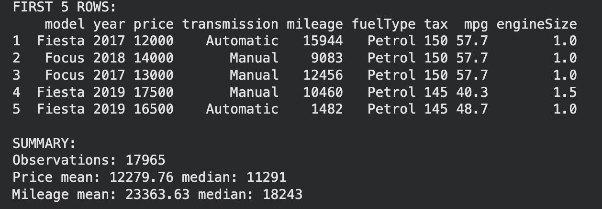
Here is a sample of our dataset (first 5 rows):

Slide 3
Columns chosen for the visualization:
Price — Dependent Variable
Mileage — Independent Variable​
​
Total Rows: 17,965 and 9 columns​
​
Information about Dataset:

Slide 4
This dataset is interesting to us because (one sentence): It allows us to analyze how mileage affects the price of used ford cars.
Our Independent variable is: mileage
This Independent variable datatype is (select one): interval
Our Dependent variable is: Price
This Dependent variable datatype is (select one): Interval
Dataset ID: (ds179 – 100,000 UK Used Car Dataset (Ford)
)

Slide 5
Template : Interval vs interval (Correlation)
Is there a significant relationship between car mileage and car price in used ford vehicles?
Null hypothesis (H₀): There is no significant relationship (Correlation) between mileage and price of used Ford cars.
Alternative hypothesis (H₁): There is a significant relationship (correlation) between mileage and price of used Ford cars.
Our Research Question is:

